Slide 1
ONLINE VOTING SYSTEM USING JAVA & PYTHON
Advanced Programming Practice Mini Project
Anitej Mishra (ra2211029010023)
prem LOHIA (ra2211029010007)

Slide 2
TITLE OF THE PROJECT and INTRODUCTION
Every now and then, we must decide on things via voting. What should we do, whom should we invite, who will be the next president of our organization? The scale can range from college sections all the way to nation-wide general elections.
Our objective is to make an Online Voting System using the Java and Python programming languages and other platforms to make voting on a topic easy, accessible and simple for everyone. Our system will also enable the organization to easily keep a track on the voting and tabulate the results.

Slide 3
ABSTRACT OF THE MINI PROJECT
This project introduces an innovative Online Voting System designed to simplify and modernize the election process within the scale of college organizations.
Leveraging the capabilities of Java and Python, we've created a user-friendly platform that enhances accessibility, security, and efficiency.
People can easily and securely cast their votes and monitor real-time election results.
The organization can keep a track of the voting and then tabulate and publish the results of the same, in a transparent and accurate way.
This system not only streamlines the entire election procedure but also encourages higher participation, transparency, and accuracy in college elections.

Slide 4
Algorithm used
Voter
organization
Start
Register for voting
Validate identity and authenticate
Create the virtual ballot
Cast the vote
Confirm the vote and display the appropriate message
Stop
Start
Initialize the system
Register the candidates/options
Register the eligible voters and their identities
Implement security measures
Track the voting process
Close the voting once completed
Tabulate and display the results
Stop

Slide 5
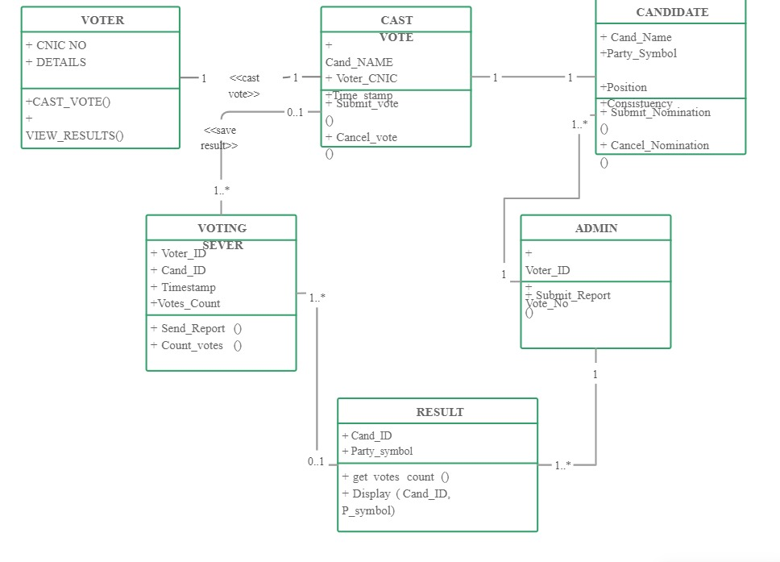
Architectural diagrams 1. CLASS DIAGRAM

Slide 6
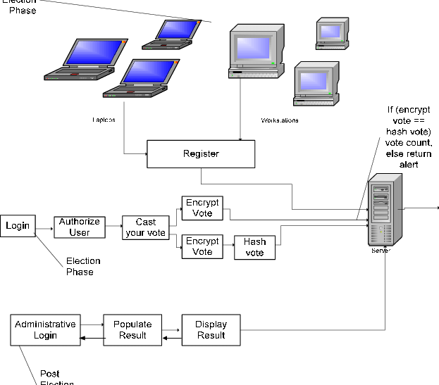
Architectural diagrams 2. SYSTEM ARCHITECTURE

Slide 7
THANK YOU!
Submitted by
Anitej Mishra (ra2211029010023)
Prem lohia (ra2211029010007)

